Slide 1
Communication and Culture
By Asmaa and Heba

Slide 2
Culture
Culture is one of the most challenging aspects of business today.
Culture can be defined as the beliefs, behaviors, norms, values, attitudes, customs, rules, and language that people share in a particular area or group.
Culture influences how people collaborate within a team and their performance.
When people with different cultural backgrounds work together, misunderstandings can arise.
When a person understands and appreciates other people's culture, they are more likely to have successful interpersonal communication.

Slide 3
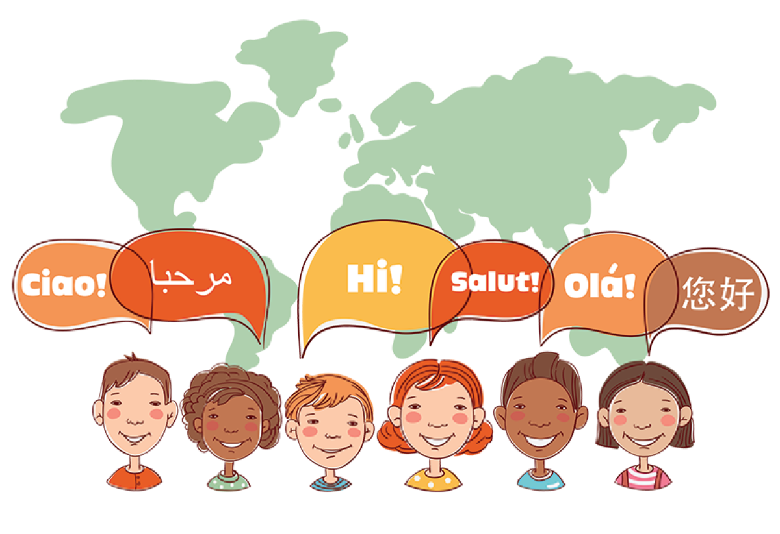
How Culture Affects Communication
Cultural differences have many effects on communication.
People with different cultural backgrounds communicate using different styles.
Their language, words, gestures, and phrases may differ even in their application.

Slide 4

Gestures Used In Communication In Different Parts Of The World

Slide 5
Cultural Differences in Communication
.
Cultural differences that manifest in communication refer to the variations observed between people engaging in a conversation due to differences in their values, beliefs, norms, and behaviors. One can address these differences and communicate effectively by being more culturally sensitive.
Cultural sensitivity refers to the awareness of commonalities and variations in people's cultures without labeling them as desirable or undesirable.

Slide 6
Culture Difference Examples : Food Customs From Around The World
In India: it is a part of their culture to eat with their hands. But, in some parts of the world, it is considered inappropriate.
The Middle East: Never use your left hand while eating, if you reach out for food or eat with your left hand, it might seem disrespectful and unhygienic.
in Thailand: Just remember one thing - in this country, it is considered rude to use the fork to put food into your mouth. The people here believe that the fork must be used only to push food into the spoon. You can then use the spoon to eat the food.

Slide 7
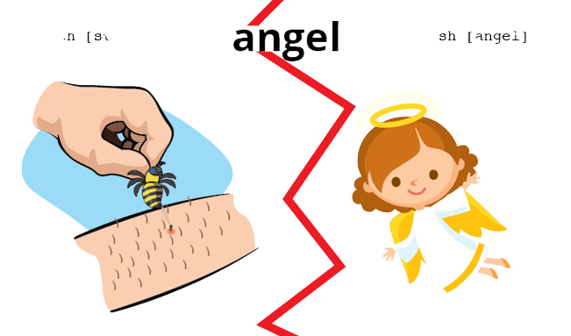

Culture Difference Examples : Words That Mean VERY Different Things In Other Countries
Grand
U.S. – Means stately or impressive
Ireland – ‘grand’ simply means ‘fine or alright’
Gift
U.S. – A present
Germany – Poison
Handy
U.S. – means something is useful as “that came in handy’
Germany – Cell phone
.

Slide 8
Culture Difference Examples : What being punctual means in different countries
Time is valued differently across cultures. In some places, like Switzerland or Germany, punctuality is important. Tardiness is unacceptable and often viewed as disrespectful.
Some cultures, on the other hand, don’t stress punctuality. They might be an hour late, a day late, a week late. And that’s a-okay. Time is not ruled by a schedule, and neither is business.
For instance, being just one minute behind in Japan is considered being late, whereas meeting on "Moroccan time" can mean anything from being an hour up to an entire day late for a promised get together.
.

